Slide 1


Slide 2
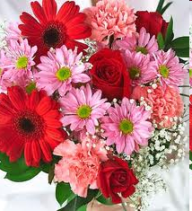

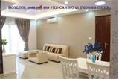
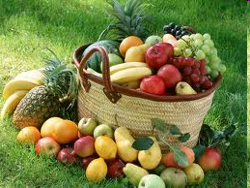
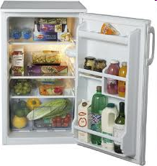

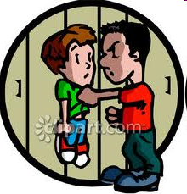
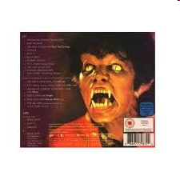
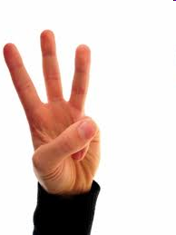
WARM - UP
MATCH THE PICTURES
flower
thriller
French
fruit
threaten
flag
flat
fridge
three

Slide 3
UNIT 8: CELEBRATIONS
LANGUAGE FOCUS

Slide 4

PRONUNCIATION
Listen and repeat
/ fl /
/ fr /
/ θr /
flower
fruit
threaten
flag
French
three
flat
fridge
thriller
Practise reading aloud
1. Don’t throw these little flags onto the floor, Fred.
2. We’ll have three dishes: French fries, fried fish and cauliflower.

Slide 5

KIM'S GAME
gifts
good luck
celebrating
foods
traditional
occasion
polite
housewives
excitement
grand
agrarian
pagodas

Slide 6

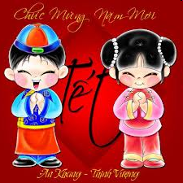
Exercise : Use the words from the box to complete the following sentences
traditional
excitement
polite
good luck
celebrating
grand
agrarian
gifts
1. Before Tet, housewives are always busy cooking .................. foods.
2. The prince’s wedding was a very .................... occasion.
3. Christmas is also the time for people to give and receive .......................
4. Each nation has its own way of ...................……. the New Year.
5. On the first day of the New Year, people often try to be nice and .................
6. People go to pagodas to pray for .................
7. If you walk on the street before Tet, you’ll find great .................... everywhere.

Slide 7
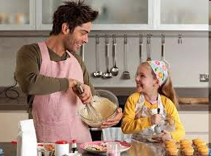
Fred and his daughter, Flora are making French fries in his flat to prepare for a New Year Eve ’s party.
A fruit cake?
Yes, I’d love to make
one
Do you want to make ?
a fruit cake
Ok. I’ll take
ones
Bring me some
oranges

Slide 8
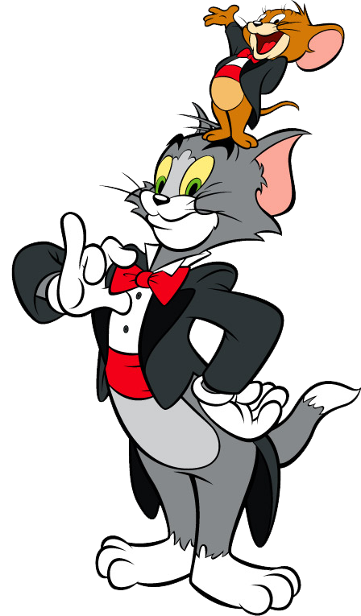
Pronouns one/ones: are used to replace a previously mentioned noun when we do not want to repeat that noun. One replaces a singular noun, and ones replaces a plural noun.

Slide 9

Exercise : Rewrite the sentences, using the pronoun one (s)
one
1. Of the three bags, I like the blue bag.
2. Mai is making a fruit cake. Huong is making a fruit cake, too.
one
ones
3. I like reading books, especially the books about the natural world.
4. I don’t have a computer, and my father doesn’t want me to have a computer.
one
one
5. They let me choose a pencil, and I took the red pencil.
6. There are several national celebrations in Vietnam, but perhaps the most meaningful celebrations is Tet holiday.
ones
ones
7. We told each other both happy stories and sad stories about our lives.

Slide 10
Fred and his daughter, Flora are making a fruit cake in his flat to prepare for a New Year Eve ’s party.
Is there anything in the fridge?
No, there’s nothing.
Has everybody arrived yet?
Nobody.
There’s someone at the door.
Ok. I’ll answer it.

Slide 11
INDEFINITE PRONOUNS
An indefinite pronoun is a pronoun that refers to one or more unspecified beings or objects.
Everyone
Everybody
Everything
Someone
Somebody
Something
No one
Nobody
Nothing
Used in affirmative sentences.
Anyone
Anybody
Anything
Used in negative and interrogative sentences.
An indefinite pronoun usually takes a singular verb.

Slide 12
Exercise : Complete the sentences, using someone, anyone, no one, or everyone. Use each word twice.
anyone
1. I don’t think ____________ likes the film. It’s so boring.
Someone
2. ____________phoned while you were out, but they didn’t leave a message.
anyone
3. Does _______________ mind if I eat first?
someone
4. There’s____________ at the door. Can you go and see who it is?
no one
5. He didn’t come to class for three days, and ____________ knows where he is.
everyone
6. Can we start now? Has ______________ arrived?
no one
7. Everyone said they would attend the party, but __________ turned up.

Slide 13
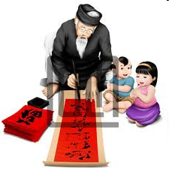
MULTIPLE CHOICE
_“ I need some fruit. Can you get some from the fridge for me?”
– “ …………………………………” A. No, thanks B. Yes, please C. Certainly D. Yes, thank you
2. ______ people are those who earn their livings on agriculture.
traditional B. agrarian C. polite D. grand
3. I can’t go to a party. I haven’t got ___________ to wear. A. anything B. everything C. something D. nothing
4. Flora was sad because ______ remembered her birthday.
A. someone B. anyone C . everyone D. no one
5. I’m making myself a cup of coffee. Would you like ________?
A. someone B. anyone C. one D. ones

Slide 14
HOMEWORK
Learn all the rules by heart.
Do the exercise at home.
Prepare Units 1, 2 well for the Revision.

Slide 15

MISTAKE RECOGNITION
1. There isn’t no one waiting for me, isn’t there?
A B C D
2. Someone spoke to me, but I can’t remember its name.
A B C D
3. Anyone stole the money, but we don’t know who.
A B C D
4. Someone would tell me the answer, so I guessed.
A B C D
5. There are someone wanting to see you outside.
A B C D

